Slide 1
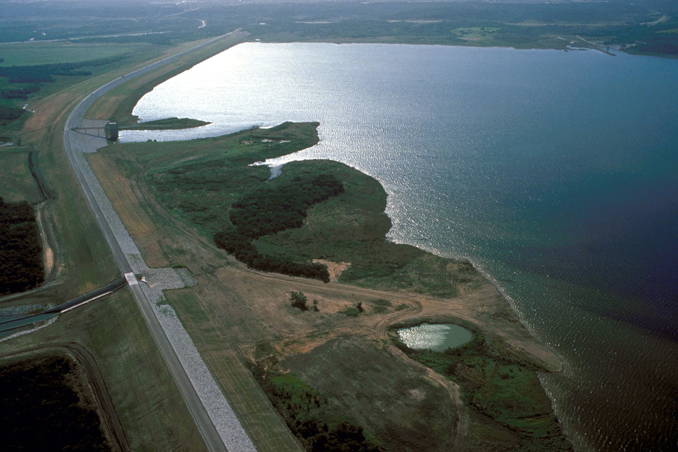
EWN FY24 End of Year In-Progress Review
UPDATE THIS PHOTO
Name of Project: Integrating water resources infrastructure with agricultural land management to advance nature-based solutions for water quality
Project Code: ASU-03
PI Name(s): Todd Steissberg, Rebecca Muenich, Selcuk Candan
Funding per FY ($K, add/remove columns as needed)
FY22 | FY23 | FY24 | FY25 | - | TOTAL
$0K | $395K | $205K | $395K |  | $995K

Slide 2
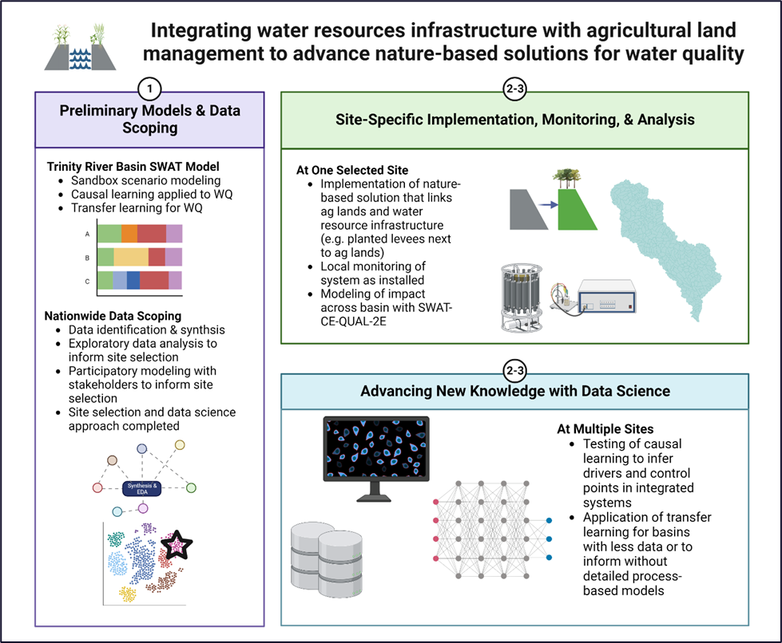
ERT-ASU-03: Project Objectives
Identify the potential for integrated management of upland areas and traditional water resources infrastructure (e.g., reservoirs, levees) across the U.S.
Select and model at least one of these systems at the watershed-scale, based on data scoping and stakeholder preferences from objective 1.
Implement, test, and monitor the performance of at least one nature-based solution in the selected system.
Develop methods to transfer learning and emulation modeling techniques to simulate and understand processes driving and controlling water quantity and quality in these integrated systems.
Apply the models, methods, and data from objectives 1-4 to demonstrate the applicability of this integrated system management in basins across the U.S.
Notes:
Describe the project objectives as described in the PMP, using a few bullets. Add a couple of project photos. If you’d like to share additional photos, please put these in the last slide of this slide deck.

Slide 3
ERT-ASU-03: Research Deliverables
Deliverables | Completed (Y/N) | If no, anticipated date? | Sent to EWN Comms? (Y/N)
Multiple SWAT scenarios exploring links and impacts on water quality | Y and N | 12/31/2023 Scenarios run for water quantity but not quality | N
Causal learning maps and analysis | Y and N | 12/31/23 Scenarios run for water quantity but not quality | Y (publications and several conference presentations on quality)
Comprehensive list of data, sources, and metadata | N | 12/31/23 | N
Database of cleaned, transformed, and ready to use data | N | 12/31/23 | N
Data results to answer initial questions about the feasibility of integrating ag land management with gray infrastructure management | N | 02/01/24 | N

Slide 4
ERT-ASU-03: Project Highlights in FY24
Publications
Azad FT, Candan KS, Kapkiç A, Li M-L, Liu H, Mandal P, Sheth P, Arslan B, Chowell-Puente G, Sabo J, Muenich RL, Redondo Anton J, Sapino ML. (2024). (Vision Paper) A Vision for Spatio-Causal Situation Awareness, Forecasting, and Planning. ACM Trans. Spatial Algorithms Syst. 10, 14:1-14:42. https://doi.org/10.1145/3672556
Presentations
Presented:
[Invited] Muenich RL. Changing the paradigm of watershed-scale water quality modeling in the age of machine learning. Arkansas State Section Meeting of the American Society of Agricultural & Biological Engineers. October 4, 2024, Fayetteville, AR.
Muenich RL, Villarreal D, Haggard B. Advancing water quality modeling and management through a focus on misfit data. American Society of Agricultural & Biological Engineers. July 29-31, 2024, Anaheim, CA.
Villarreal D, Liu T, Deng Q, Steissberg T, Sabo JL, Muenich RL. Assessing the Potential Role that Integrated Agricultural Reservoir Systems Have on Water Quality. Network for Engineering with Nature Partner Symposium. May 22-24, 2024, St. Augustine, FL.
[Invited] Villarreal D. Managing complex water resources systems: The case of agriculture, dams, and water quality. AGU Data Visualization Student Showcase. April 29, 2024, Washington, D.C.
Liu T, Deng Q, Wei Y, Sheth P, Ding K, Sabo JL, Muenich RL. Basin-Scale Modeling of Collective Management Practices in Agriculture to Reduce Sediment and Nutrient Inputs into Flood-control and Drinking Water Reservoirs.
Liu T, Deng Q, Ding K, Sabo JL, Liu H, Candan KS, Muenich RL. Applying Graph Neural Networks to Improve the Data Resolution of Stream Water Quality Monitoring Networks. American Geophysical Union Annual Meeting, December 12-15, 2023, San Francisco, CA.
Villarreal D, Liu T, Deng Q, Steissberg T, Sabo JL, Muenich RL. Do upland agricultural areas and downstream reservoirs counteract efforts to improve water resources? American Geophysical Union Annual Meeting, December 12-15, 2023, San Francisco, CA.
Notes:
Describe the current project highlights, including major events, activities, deliverables, and/or accomplishments. Include the date of achievement/completion for each highlight.

Slide 5
ERT-ASU-03: Project Highlights in FY24
Presentations
Recently Accepted
Liu T, Wei Y, Deng Q, Candan KS, Sheth P, Muenich RL, Mandal P. Comparison of agricultural activities and reservoir management on water quality at the watershed-scale. American Geophysical Union Annual Meeting, December 9-13, 2024, Washington, D.C.
Villarreal D, Muenich RL, Liu T, Steissberg T, Deng Q, Sabo JL, Rashid B. Quantifying the Role of Integrated Agricultural-Reservoir Systems on Water Quality. American Geophysical Union Annual Meeting, December 9-13, 2024, Washington, D.C.
Data/Code Outputs
Land use analysis of contributing areas for dams.
Developed a SWAT parameter database to help with machine learning integrations with SWAT.
Finalizing a water quality integrator code that synthesizes data for them Water Quality Portal by identifying multiple combinations of parameters that can represent the same kind of observation.
Ground-truthed verified National Inventory of Dam dataset
Shapefile of contributing area for all ~90,000 dams in the National Inventory of Dams
Notes:
Describe the current project highlights, including major events, activities, deliverables, and/or accomplishments. Include the date of achievement/completion for each highlight.

Slide 6
ERT-ASU-03: Project Highlights in FY24
Other Outcomes
Becca Muenich is leading a working group on agriculture within NEWN.
Danna Villarreal received the Reginald R. “Barney” & Jameson A. Baxter Graduate Fellowship at the University of Arkansas.
Danna Villarreal received the Philanthropic Educational Organization (P.E.O.) International Peace Fellowship.
Danna Villarreal spent two weeks in California training on the CE-QUAL-W2 model with USACE partner Todd Steissberg.
Danna Villarreal won “Best Science Communication” for her poster “Assessing the Potential Role that Integrated Agricultural Reservoir Systems Have on Water Quality” at the NEWN Partner Symposium in May.
Becca Muenich organized a panel on “Integrating agriculture to advance the next frontier of engineering with nature” at the NEWN Partner Symposium in May.
Notes:
Describe the current project highlights, including major events, activities, deliverables, and/or accomplishments. Include the date of achievement/completion for each highlight.

Slide 7
ERT-ASU-03: Status of Project Activities
Activity | Deliverable | Comms / Technical Transfer Plan | Lead POC | Original Start Date (MM/YYYY) | Actual Start Date (MM/YYYY) | Original End Date (MM/YYYY) | Actual End Date (MM/YYYY) | Budget ($K) | Percent Complete (%) | Notes
Exploratory modeling analysis of combined ag lands + reservoir management | Multiple SWAT scenarios exploring links and impacts on water quality | Journal publication, webinar, EWN website content | Liu | 08/2022 | 10/2022 | 12/2022 | 12/2024 | 71.9 | 80% | Quantity done; quality calibration is taking longer (and now have additional task for this)
Exploratory analysis of causal learning to understand water quality outcomes | Causal learning maps and analysis | Journal publication, webinar, EWN website content | Candan | 08/2022 | 10/2022 | 07/2023 | 12/2024 | 66.2 | 80% | Quantity done; quality still ongoing
Identify data to be used in large scoping activity | Comprehensive list of data, sources, and metadata | N/A- internal outcome | Muenich | 10/2022 | 1/2023 | 01/2023 | 12/2023 | 51.3 | 100% | List mostly complete
Synthesis and transformation of data for scoping | Database of cleaned, transformed, and ready to use data | N/A – internal outcome | Muenich | 02/2023 | 5/2023 | 05/2023 | 5/2024 | 66.3 | 100%
Notes:
Complete this table for your project. Include all activities and deliverables, including ones that were modified or deleted, as well as ones that were added along the way. Use the notes column to add additional explanation or notes on modifications in the activities, deliverables, or start/end dates.
Use multiple tables/slides if needed.

Slide 8
ERT-ASU-03: Status of Project Activities
Activity | Deliverable | Comms / Technical Transfer Plan | Lead POC | Original Start Date (MM/YYYY) | Actual Start Date (MM/YYYY) | Original End Date (MM/YYYY) | Actual End Date (MM/YYYY) | Budget ($K) | Percent Complete (%) | Notes
Exploratory data analysis of scoping data | Data results to answer initial questions about the feasibility of integrating ag land management with gray infrastructure management | Journal publication, EWN website content, webinar | Muenich | 06/2023 | 8/2023 | 08/2023 | 5/2024 | 55.5 | 100%
Site selection for model and demonstration studies | Watershed in the U.S. to be used for demo and SWAT-CE-QUAL-W2 model development | N/A – internal outcome | Steissberg | 08/2023 | 05/2023 | 12/2023 | 09/2023 | 83.8 | 100%
Total |  |  |  |  |  |  |  | $395.0
Notes:
Complete this table for your project. Include all activities and deliverables, including ones that were modified or deleted, as well as ones that were added along the way. Use the notes column to add additional explanation or notes on modifications in the activities, deliverables, or start/end dates.
Use multiple tables/slides if needed.

Slide 9
ERT-ASU-03: Delays and difficulties
The ERDC team’s budget reductions for FY24 required pausing development of the linkage of SWAT with CE-QUAL-W2. This task is ready to move forward when funding is available.
Notes:
Please include a bullet list of delays and/or difficulties with project activities or deliverables. Indicate how delays/difficulties are being addressed and managed, and the anticipated dates for getting back on track.

Slide 10
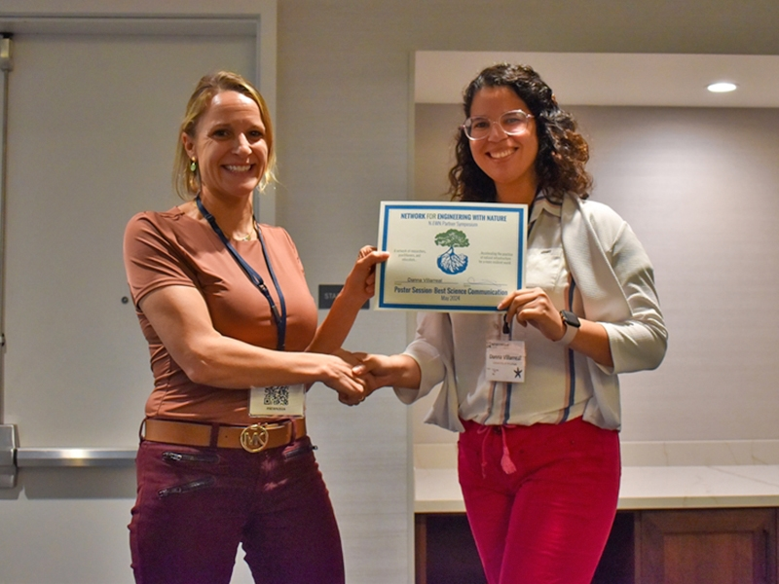
ERT-ASU-03: Anything else you’d like to add?
Danna Villarreal won “Best Science Communication” for her poster “Assessing the Potential Role that Integrated Agricultural Reservoir Systems Have on Water Quality” at the NEWN Partner Symposium in May.
Notes:
Use this slide to add any other updates or notes about your project, or to share more photos.

